Slide 1

LA Hillside Road Demand Analysis
Junwon Choi, B.S. in Data Theory (University of California, Los Angeles, 2024)
Sensors and Robotics for Infrastructure Lab (SRI Lab)

Slide 2
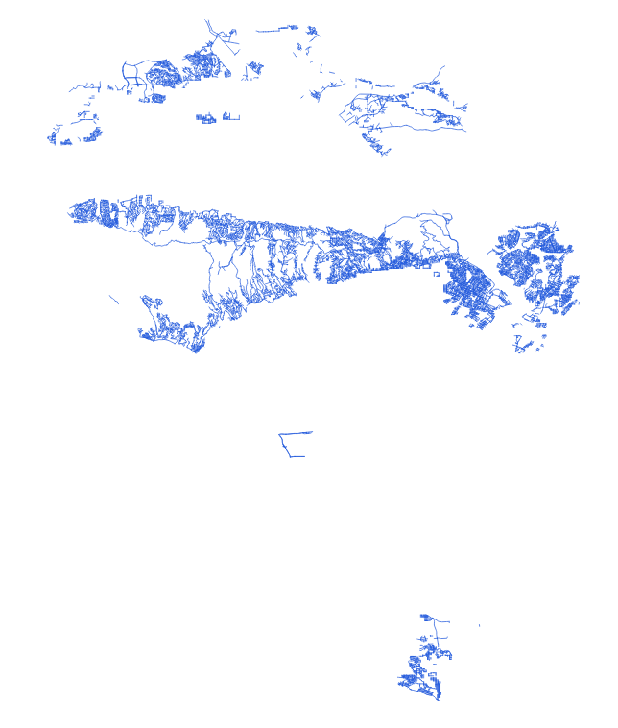
Objectives
Main: Provide an alternative method of estimating road demand in the hillside street segments of the LA transportation system using graph data and the LEHD Origin-Destination Employment Statistics (LODES) dataset from the U.S. Census Bureau.
Additional: Visualize traffic estimates based on demographic data.
Notes:
Ultralitics and YOLO v5 or v8

Slide 3
Packages/Models Used (Python)
Spatial Data Packages
GeoPandas: geospatial data handling
Shapely: geometry (block) object handling + manipulation
Rtree: spatial indexing
NetworkX: shortest path algorithm implementation
SciKit-Gstat: geostatistics models (Variogram, OrdinaryKriging)
Dijkstra Algorithm: shortest path computation [NetworkX - single_source_dijkstra_path]
Kriging Interpolation: weight interpolation for unidentified points [SciKit-Gstat - Variogram + OrdinaryKriging]
Key Models
Notes:
Ultralitics and YOLO v5 or v8

Slide 4
Datasets
Block shapefile: geocode + polygons of blocks in LA
Population Origin-Destination: number of jobs/workers based on home and work Census Block
Graph representation of LA (hillside): Node: Coordinates of road (intersection) points Edge: Roads (node connections)
Notes:
Ultralitics and YOLO v5 or v8

Slide 5
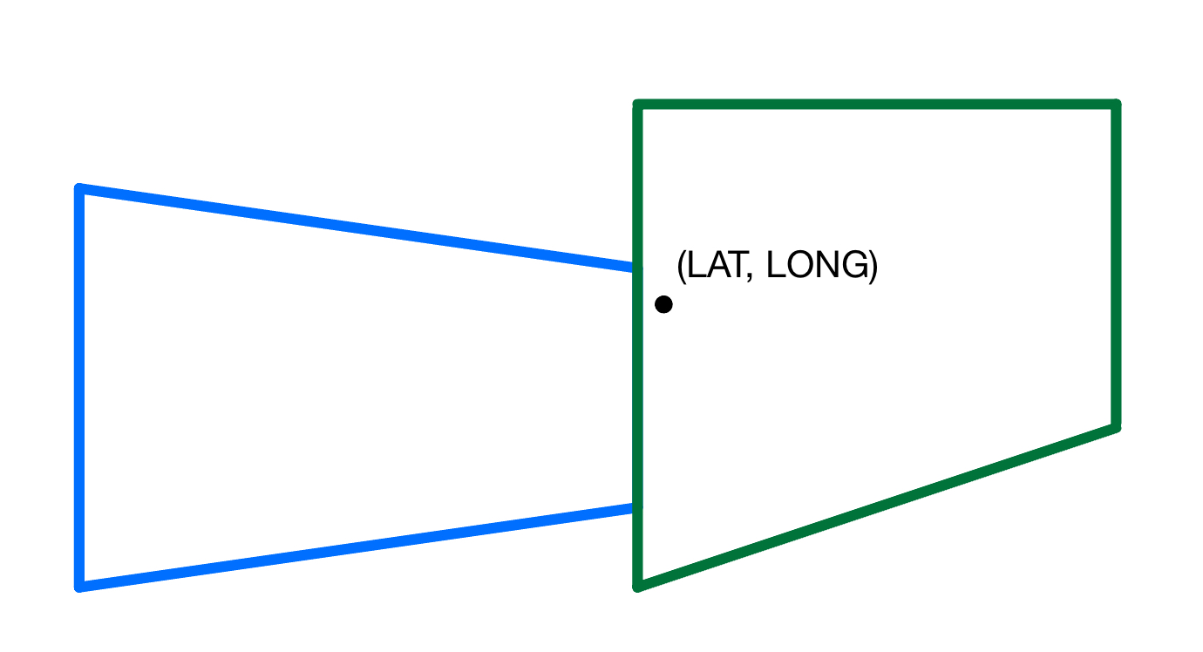
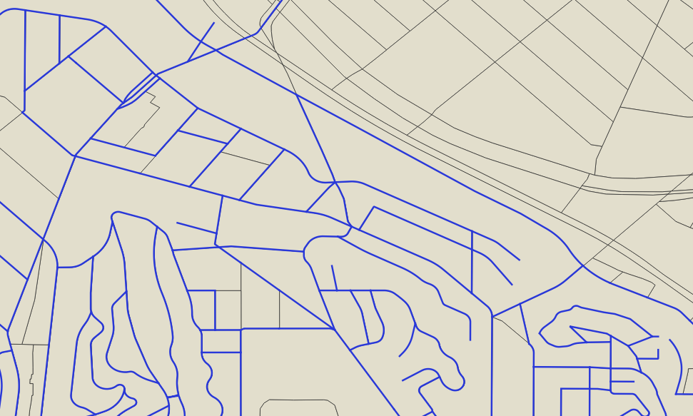
Step 1: Block Determination
Task: Identify which block each node belongs to.
Approach: Check node against block boundaries.
→ Node must be contained within the 4 block boundary coordinates.
Challenge: Computationally demanding.
Solution: Utilize R-tree indexing for efficient finding of intersecting search rectangles.

Slide 6
Step 2: Node Origin-Destination Data Pairing
Task: Combine results from Step 1 with the Origin-Destination dataset to append job/worker quantity for each node.
Approach: Series of indexing, merging, expanding rows to produce merged dataframe.
Challenge: Duplication of block usage.
Solution: Create (distributed) adjustment columns to account for block usage duplication.
Origin-Destination
Step 1 Results
Block geocode (work) | Block geocode (home) | S000 | … | SI03
⋮ 060371352052007 ⋮ | ⋮ 60014001001003 ⋮ | ⋮ 21 ⋮ | … | ⋮ 3 ⋮
Node # | Block geocode | Block polygon
⋮ 123 ⋮ | ⋮ 060371352052007 ⋮ | ⋮ <POLYGON ((-118.668 34.183, -118.668 34.183, -118.667 34.183, -118.667 34.18...> ⋮
+

Slide 7
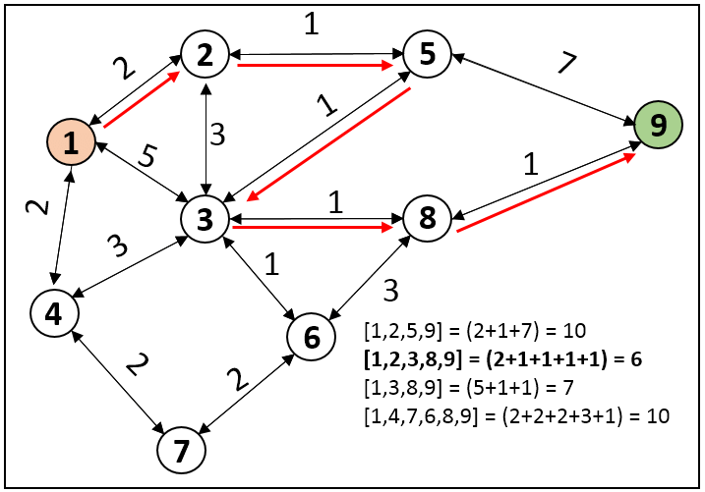
Step 3: Shortest Path Determination
Task: Implement shortest path algorithm to approximate optimal traveling path between two nodes.
Approach: Apply the Dijkstra Single-Source algorithm to all nodes in dataset.
nx.single_source_dijkstra_path - computes the shortest paths between a source node and all nodes reachable from that node
Dijkstra’s Algorithm (Source)
Graph in QGIS

Slide 8
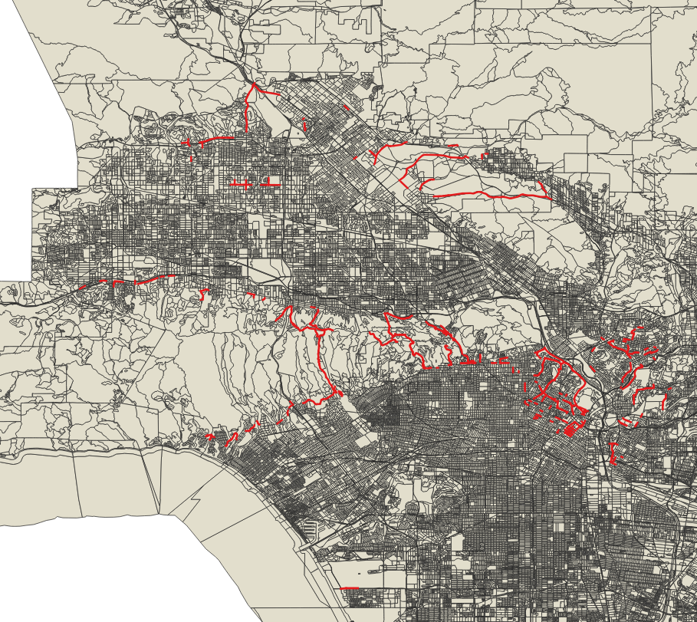
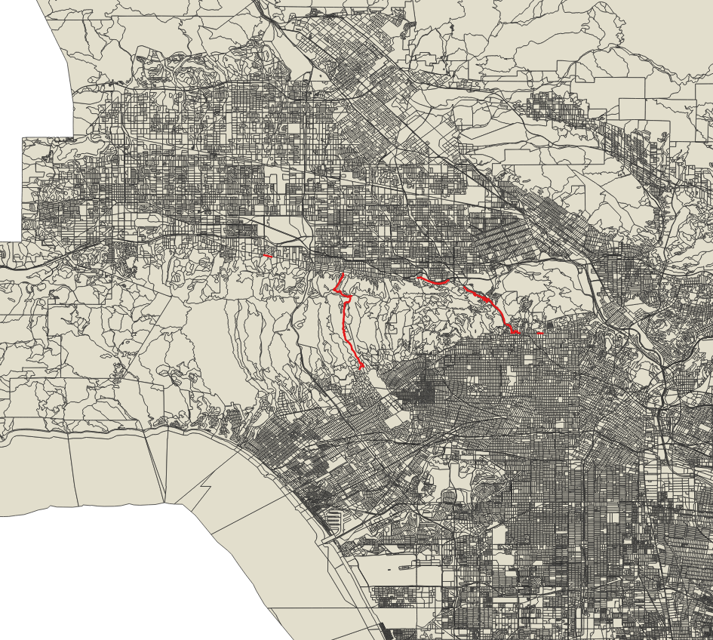
Step 4: Path Usage Estimation
Task: Compute road demand based on results from Step 3.
Approach: Efficiently iterate over all node-to-node connections from all shortest paths to compute relative usage for each road.
Graph in QGIS
["S000_adjusted" >= 0.01]
Graph in QGIS
["S000_adjusted" >= 0.50]

Slide 9
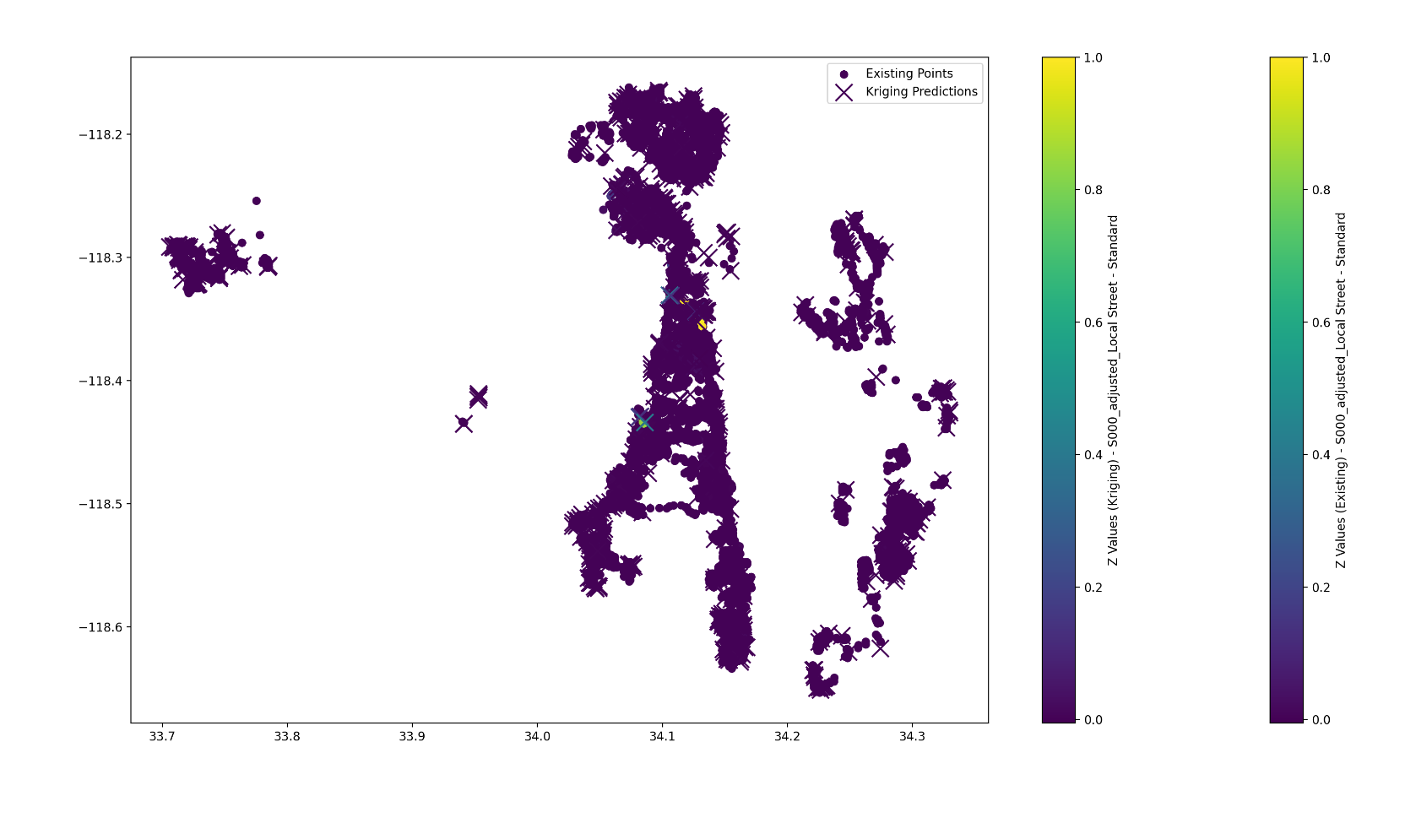
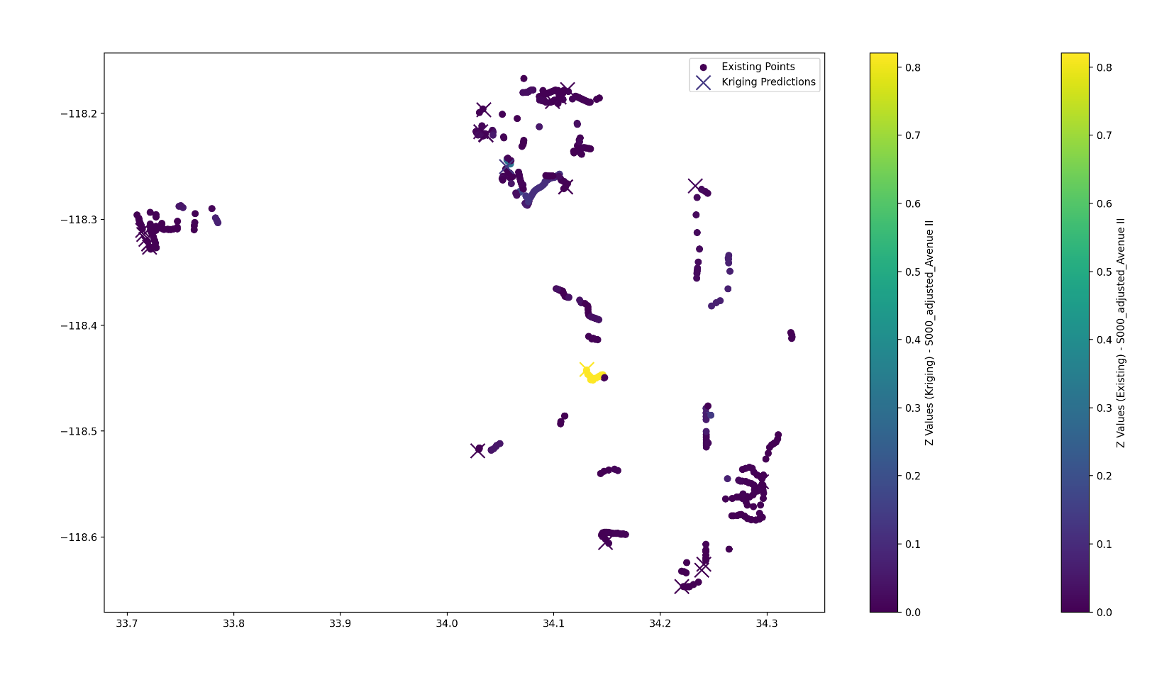
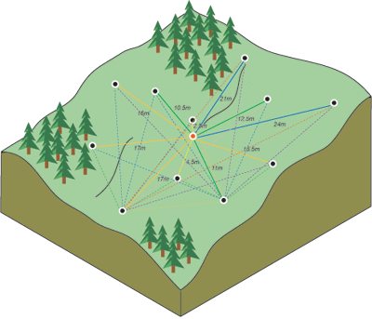
Step 5: Address Missing Weights - Kriging
Task: Address nodes with unidentified usage levels.
Approach: Utilize Kriging interpolation to estimate missing levels based on neighboring nodes.
Calculating the difference squared between the paired locations (Source)
Kriging results plotted
[Left: S000/Local Street, Right: S000/Avenue II]

